Slide 1
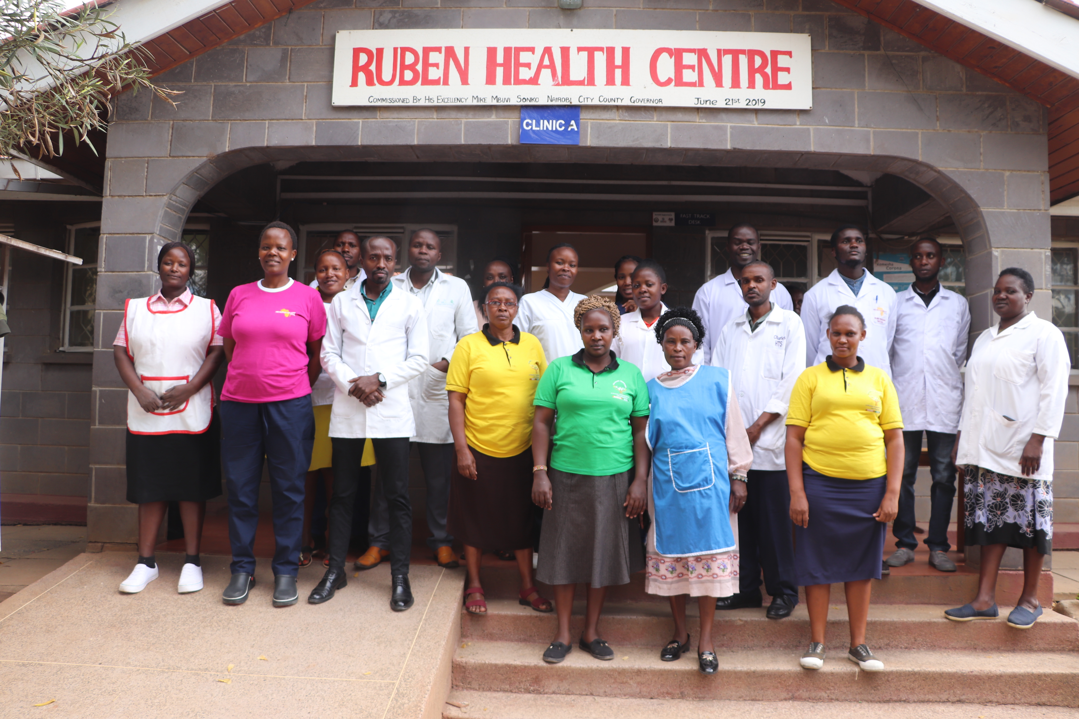
RUBEN HEALTH CENTRE
2023 1ST QUARTER PERFORMANCE REPORT.

Slide 2
1. INTRODUCTION.
Ruben health Centre is a primary health care facility categorized as level 3B as per the ministry of health.
We offering 5 different types of services as listed below;
Preventive services.
Promotive services.
Curative services.
Rehabilitative services.
Maternity services.

Slide 3
2. CURATIVE /CONSULTATION SERVICES
 | January | February | March | Total
Patients | 688 | 872 | 1049 | 2,609
workload | 1225 | 1589 | 1760 | 4,574
Provision of Preventive and curative services. In the 1st 3 months (1st quarter) 2023, a total of 2609 patients were attended.
January : 688 patients.
February : 872 patients.
March : 1,049 patients.
Services that were in the respective months are as follows.
January : 1225 services.
February : 1589 services.
March : 1760 services
The top 10 conditions this year (2023);
URTI- upper respiratory tract infections: 588 cases
UTI- urinary tract infections: 162
Hypertension: 90
Pneumonia: 82
Diarrhoea: 79
Diabetes: 62
Eye infections: 59
Skin conditions: 52
Intestinal worms: 43
Rickets :41
32 out patient referrals were done to high medical levels.

Slide 4
3. MCHN (maternal child health and nutrition)
ANC | January | February | March | Total
Patients | 62 | 51 | 76 | 189
workload | 278 | 316 | 320 | 914
Departments under MCHN includes;
Ante natal clinic,
Maternity services,
Post natal clinic,
Child welfare clinic (growth monitoring and immunization),
Reproductive health/ cervical/ breast cancer screening and
Nutritional services.
ANC (Antenatal clinic)-
A total of 231 new expectant mothers started the antenatal clinic in the first 3 months 2023, this translated to 1,204 services.
January : 278 patients.
February : 316 patients.
March : 320 patients

Slide 5
3a. Maternity services-
Total number of deliveries conducted are as follows;
January: 73 deliveries.
February: 74 deliveries.
March: 84 deliveries.
231 mothers delivered in the first quarter 2023. if this data is compared to the same period last year 2022 where 321 mothers gave birth, this indicates a 28.04% decrease. The monthly target this year is 86 deliveries but we managed to deliver an average of 77 mothers.
To date a total of 4978 deliveries have been successfully conducted with 5284 babies since the inception of the birth services.
22 teenagers (14-19 years) gave birth at Ruben maternity.
On a sad note we have lost
15 neonates majority being still birth.
1 maternal death happened during referral process.
16 Mothers were referred for cesarean sections or for specialized attention arising as a result of complications such as PET or PPH.
For PMTCT indicator
A total of 8 HIV positive mothers delivered in our unit, all the mothers were linked to ccc clinic and their children are followed.

Slide 6
3b. Child welfare clinic.
Provision of Growth monitoring and nutritional assessment services,
A total of 2,989 children received growth monitoring and immunization services, this translated to an average of 990 children monthly.
We have noticed a drop in the number of children brought for immunization and growth monitoring for the past few months because of delays for supply of vaccines from the sub-county, stock outs and the establishment of the government level 4 facility next to Ruben Centre that gives immunization services for free.
1,332 children were immunized.
219 children were fully immunized.
In the past 5 years, We noticed a decrease in the number of mothers seeking PNC services who delivered at the chemists or home as compared to the previous years. 1,106 mothers received Post natal care services in the last 3 months of the year 2023.
On the other hand, the total of 252 WRA ( women of reproductive age) received reproductive health services.

Slide 7
3c. NUTRITION SERVICES.
Total admission of children under 5 years to supplementary feeding program was as follows
January : 10 admissions.
February : 8 admissions.
March : 6 admissions.
Total number discharged/ cured from the program is 12.
In severe acute malnutrition clinic (outpatient therapeutic clinic OTP)
January : 8 children were enrolled
February 19 children were enrolled.
March 16 children enrolled.
13 children discharged from the program in the 1st 3 months of the year.

Slide 8
4.Rehabilitative services (OT/PHYSIO)
Number enrolled to occupational and physiotherapy programs every month are as follows;
January : 16 clients.
February : 18 clients.
March : 12 clients.
7 clients were discharged from the program.
974 sessions were offered.
Major conditions dealt with includes; cerebral palsy, hemi paresis, down syndrome and rickets.
In physiotherapy clinic,
A total of 46 admissions were achieved with 254 sessions.
1 support group meetings for parents & caregivers of children with special needs was conducted 70 caregivers were provided with psychosocial support and nutritional support.
On the other hand, LBP, stroke and MSK injury also dominates the cases dealt with in physio clinic.

Slide 9
5. DENTAL SERVICES
There is a decrease in the number of new clients seeking dental services from our unit. In the past 3 months, 177 clients were attended.
Extractions 102.
Filling 11.
FMS ( scaling) 5.
Lack of a community a permanent stationed oral health officer (COHO) to offer this service in the unit is the main challenge.

Slide 10
6. LABORATORY SERVICES
A total of 3557 Lab. tests were conducted;
January : 961 tests.
February : 1,037 tests.
March : 1559 tests.
We succeeded in registering the laboratory as per the the Ministry of health directives. The laboratory is now fully compliant.

Slide 11
6. Comprehensive care clinic (ccc)/TB and HTS
A total number of 781 people were tested for HIV status.
January: 2 positives.
February: 6 positives.
March: 11 positives.
Out of the total number tested, 19 were positive clients and were enrolled to care in, this translates to 2.43% positivity late.
There are a total of 880 HIV active clients seeking care and treatment at Ruben health Centre.
In TB program,32 clients were enrolled to care.
30 got cured and were discharged from the program

Slide 12
AT RUBEN HEALTH CENTRE- WE LISTEN WE CARE.
PREPARED BY ONDIEKI BEN ………………………………………………………………………………………..THANK YOU.

